Slide 1
Introduction to DATA STORAGE

Slide 2
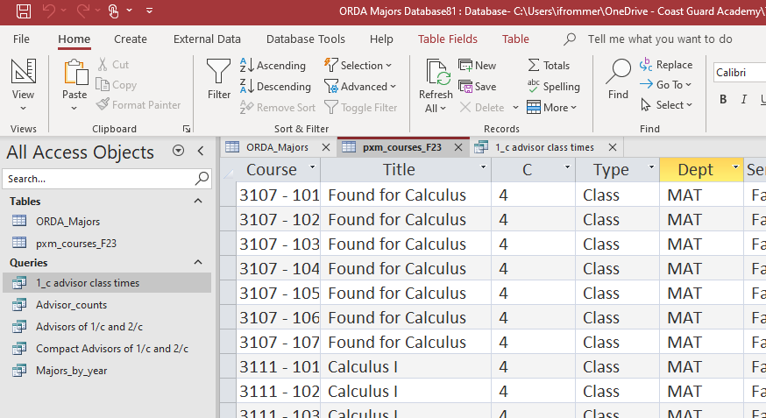
Demonstration
See ORDA Majors database

Slide 3

Today
I. Introduction to data storage/management
  Contrast 2 approaches:
    Traditional approach
    Database approach
  Basic database terminology
II. Introduction to Access

Slide 4
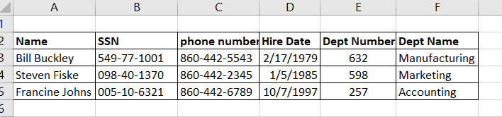
1. Traditional Approach to Data Management
Storing data in “flat files”, such as a text file or a csv file, i.e. 2-dimensional data

Slide 5
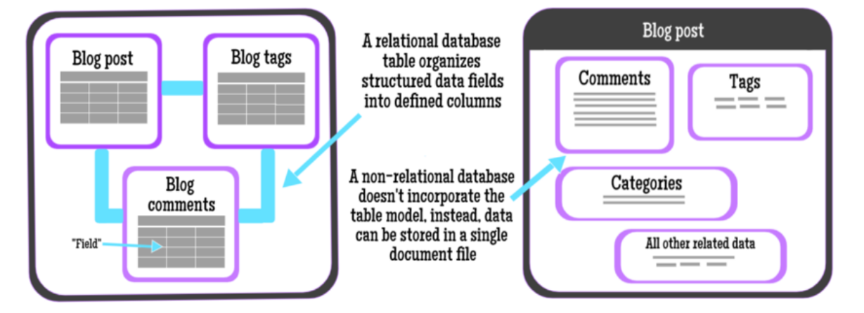
2. Database Approach
Database Types:
1. Relational (SQL) 2. Non-relational (NoSQL)
SQL = Structured Query Language NoSQL = Not Only SQL
Source: https://medium.com/@lizparody/databases-for-frontend-developers-2a4e9f16b7b4

Slide 6
Relational Databases use Linked Tables that Capture Relationships

Slide 7

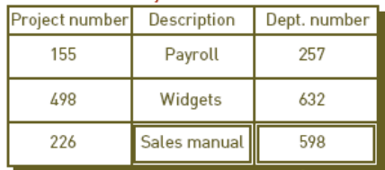

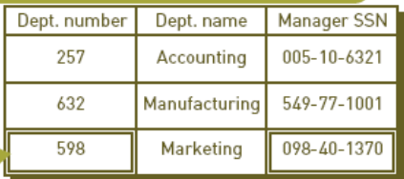
Rough Visualization of Table Relationships

Slide 8



Aspects of Relational Databases
Contain structured data
  Structured data has defined datatypes (zip-codes, dates, long-text, etc.)
Data items have pre-defined relationships between them
Data are organized as a set of 2-dimensional tables
Each row in a table has a unique identifier
Database can be queried in many different ways without reorganizing the tables
https://aws.amazon.com/relational-database/

Slide 9


Aspects of Non-Relational Databases
Can contain structured or non-structured data
  Non-structured data include photos, e-mails, pdfs, etc.
Store and manage data to allow for speed and flexibility
Can be scaled horizontally across hundreds or thousands of servers
Can store massive amounts of data
Don’t generally provide the same level of data consistency as SQL databases
https://www.infoworld.com/article/3240644/nosql/what-is-nosql-nosql-databases-explained.html

Slide 10
Our focus: Relational Databases
Module 2 of this course will focus on relational databases, specifically:
  Relational database concepts
  Building databases, forms, and queries in Microsoft Access
  SQL Basics

Slide 11
A Manufacturing Example
Our objectives in working with this example:
illustrate some of the kinds of questions we will be asking
show why databases might be preferred to a traditional “flat-file” spreadsheet approach
Manufacturing Company:
manufactures and sells a variety of widgets
has 3 departments each with multiple employees
  Accounting
  Manufacturing
  Marketing
uses project records to drive promotions, bonuses, and work distribution
this information is maintained with a traditional approach: Excel spreadsheets

Slide 12
Manufacturing Example:
Traditional Data Management Approach
Let’s create a traditional 2D table (or tables) for this example.
The table(s) should be for … what?
  Projects
  Departments
  Managers
We will create in Excel … how?
  Create one worksheet for each table
  Decide on column headings (“fields”) to use
  Start to fill the table with data … eventually look at completed sheets
  Go to Excel ; come back soon…

Slide 13
You should be in Excel now.
Notes:
Set up the sheets but then halt and unhide the completed sheets.

Slide 14
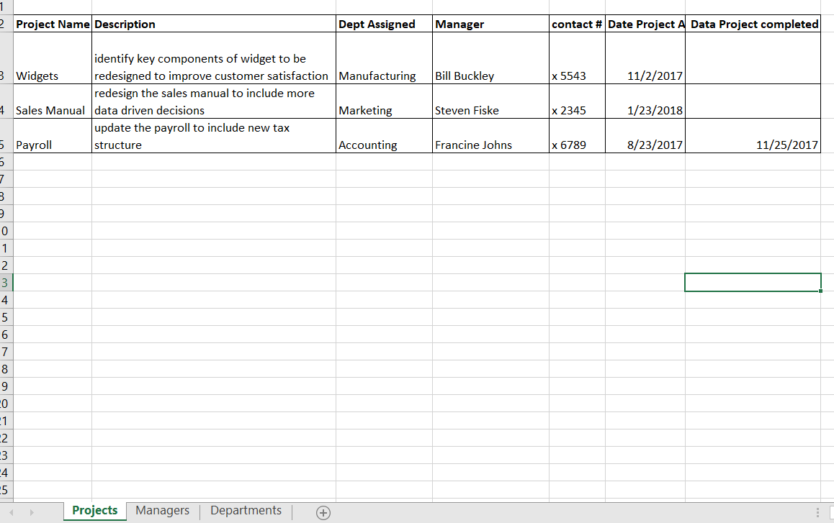
Manufacturing Ex:
Multiple Sheets to keep track of the various information for the company

Slide 15
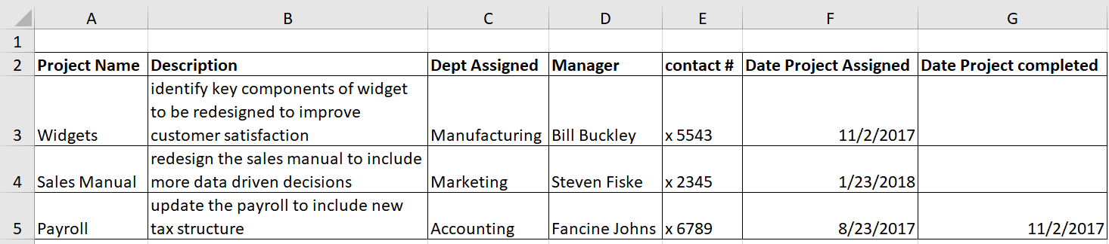
Manufacturing Ex:
Project Tab

Slide 16
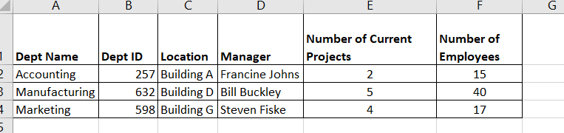
Manufacturing Ex:
Department Tab

Slide 17
Manufacturing Ex:
Manager Tab

Slide 18
Manufacturing Ex: Adding a new project
Ex. A new project “Gadgets” assigned to Manufacturing on 3/3/2018
How must the Project table be updated when a new project is created?
  Type in the new information
  Fill in Manager and contact #. How?
    Data entry person’s memory, looking at the Department table, etc. and typing in the information.
What potential problems are there with this approach?
Gadgets | … | …
Notes:
Mistakes: Maybe get the wrong manager with the project/dept (likely if there’s a turnover in management, or an inexperienced data entry person); Each time a project is entered, they have to enter the manager’s name (likely will find misspellings) as well as phone numbers (again, easy to make a typo).
Redundant: Entering the manager’s name for each project entry (dept manager will always be the same per dept– redundant to enter each time); phone number
To ensure accurate data entry, a person will likely have to reference the other two sheets on this spreadsheet to ensure the data they are entering is accurate.

Slide 19
Manufacturing Ex:
Adding a new project (cont)
The addition of the the ‘Gadgets’ project to the Project sheet necessitates an update of the Managers sheet. How shall we handle this?
Consider the info on the ‘Managers’ tab of the Excel spreadsheet:
Notes:
Number of current projects would need to be manually updated– what if someone forgets to do this when a new project is entered?

Slide 20
Manufacturing Ex: Determining Bonuses
Upper management wants to use project data to help determine bonuses across departments?
What are some key pieces of info they might look at?
How would they get to this info?
Let’s look at the spreadsheet again for some ideas.
Notes:
Maybe number of projects by department– but this might not be accurate because it’s manually entered. One could go into the project tab of the spreadsheet and sort and count the data by dept
How quickly each dept finishes the projects- a new column in Excel could be calculated to determine the length of time between start and end dates– but recall that this would be a waste of time for all current (unfinished) projects (no end date filled in)
They might want to look at the above data in the context of how many people are in each dept (ie, determine dept project productivity based on work per person)
In order to bring together any of the above information, upper management would need to reference multiple spreadsheets, manipulate the data, and possibly even build some new data columns

Slide 21
Traditional Approach to Data Management:
Potential Issues
  Data redundancy (duplication)
  Data integrity
  Large file size due to data redundancy
  Accessing, managing, and updating data may be difficult

Slide 22
Data Storage/Management Considerations
Some considerations that will affect our choice of traditional versus database and relational versus non-relational:
Ease of use / accessibility
Size of data
Data (structured or unstructured)
Security
Cost
Notes:
https://munvo.com/2017/07/18/hadoop-big-data-vs-relational-databases/

Slide 23
The Database Approach applied to the Manufacturing Example

Slide 24
The Database Approach applied to the Manufacturing Example
24
Store all data in one place
  Broken up into entities
  Entities connected with relationships
Supply an interface allowing different users to interact with data in different ways depending on the desired function.

Slide 25
Make Each Entity A Separate Table
** Tables will be linked by common columns **

Slide 26
Determine Entity Relationships
Notes:
1 manager supervises many departments
1 department performs many projects
Ex of a data call: president of the company wants the name of the manager of the sales manual project and the length of time the manager has been with the compnay

Slide 27
Tables Linked to Capture Relationships

Slide 28
Rough Visualization of Table Relationships

Slide 29
Database Approach Illustrated
Data is stored efficiently
How a user chooses how to interact with the data
Data/reports generated for users
Various programs developed to control views/interactions
Notes:
Sometimes a user ‘chooses’ how to interact with the data; other times, permissions are set such that restrict the way(s) a user can interact with the data.
Consider REGIS. Does everyone have access to the same info? As an academic advisor i have access to more information about my advisees as compared to other students who are not my advisees.
Coaches, company officers, the Dean (etc) all have different access as well.
REGIS has an application to view cadet information, but it also has an application to view course information (different Application Programs).

Slide 30
Data Element Concepts
Entity: a generalized class of people, places, things, or events (objects) ~nouns
  becomes a table in the database
  each instance of an entity is stored in a record or row
Attribute: characteristic of an entity ~adjectives
  stored in field of a record
Primary key: field or set of fields that uniquely identifies the record
Notes:
Ex: cadets can be an entity – what would be an attribute of the this table? What could be a primary key?

Slide 31
Data Element Concepts - Example
Consider maintaining data for:
  cadets,
  companies,
  divisions, and
  company officers
What are the entities you would make?
What attributes would you include for each entity?
Suggest a primary key to use for the Cadet table
Notes:
Entities:
-Cadets
-Companies
-Divisions
-Company Officers

Slide 32
Data Element Concepts - Example
Cadet Code | Name | Company | Division | Birthdate | Year
12345 | Abby Jones | Alfa | Wellness | 6/4/1999 | 2021
20090 | Wendy Wu | Echo | Transportation | 2/8/1998 | 2020
19238 | Wesley Lee | Bravo | Training | 8/2/2000 | 2022
98123 | Kevin Diaz | Charlie | Honor | 9/23/1997 | 2020
What is/are the record(s) shown?
What is/are the field(s) shown?
What are potential primary keys shown?
Notes:
Records must be unique.
Records are uniquely identified through a primary key field/attribute. This primary key may be one field, or a combination of multiple fields.
We can think of records as ‘instances’ of objects as we did with OOP last semester.

Slide 33
Relationships
Cardinality describes the relationship between two entities A and B:
  Given an instance of Entity A, how many instances of Entity B is it related to, and vice versa?
    Possible answers: a) one:one, b) one:many, c) many:many
Cadet Code | Name | Company | Division | Birthdate | Year
12345 | Abby Jones | Alfa | Wellness | 6/4/1999 | 2021
20090 | Wendy Wu | Echo | Transportation | 2/8/1998 | 2020
19238 | Wesley Lee | Bravo | Training | 8/2/2000 | 2022
98123 | Kevin Diaz | Charlie | Honor | 9/23/1997 | 2020
Course Code | Course Name | Department
3231 | Calculus I | Mathematics
2393 | Government | Humanities
1214 | Statics | Engineering
Here cadets-to-courses have a “many-to-many” cardinality.
Notes:
Given a cadet, how many courses are they in? many
Given a course, how many cadets are in them? many

Slide 34
Relationships
Cardinality describes the relationship between two entities A and B:
  One-to-one: one instance of Entity A is related to just one instance of Entity B
  One-to-many: one instance of Entity A is related to many instances of Entity B, but each instance of Entity B is related to only one instance of Entity A
  Many-to-many: one instance of Entity A is related to many instances of Entity B, and one instance of Entity B is related to many instances of Entity A

Slide 35
Relationships (Example)
Student
Section
Last Name
First Name
ID
Grad Yr
Identify the cardinality:
Course—Section
Student—Section
Student—Course
Section #
Location
Instructor
Meeting Time
Course
Course Name
Course #
Dept
Notes:
Course-Section – 1:many
Student-Section – many : many
Student-Course – many : many or no relationship, mediated through student-section and course-section

Slide 36
Relationships (Example continued)
To identify the cardinality between the entities, consider describing their relationship with words:
Course—Section
“One course can have many sections”; “one section pertains to only one course”
The relationship between Course and Section is one-to-many
Student—Section
“One student is enrolled in many sections”; “one section consists of many students”
The relationship between Student and Section is many-to-many
Is there a direct relationship between Student and Course?
Notes:
Describe the relationship between the two entities from both sides: ie, for Course and Section, we describe the relationship by (1) one Course can have many sections, and (2) one Section belongs to only one course. This relationship is one to many.
Think about how this would look: Course table would include all course info: Course title, course number, department, etc; the Section table would include specifics on the section: location, instructor, meeting time, and this section table would include the primary key from the course table (likely the course #). By including the primary key from the course table, the section is now related to the course table and all of its information.
Since the Student and Section cardinality is many-to-many, a third table must be created to capture this relationship.... Why?

Slide 37
Microsoft Access

Slide 38
Microsoft Access
Relational Database
Offers object-oriented user interface
In Access, a database is a group of related objects that are saved in one file
Objects in Access include:
  Tables
  Forms
  Queries
  Reports

Slide 39
Entities (Tables)
Table – consists of data that is structured in rows and columns (each table represents a single entity type)
Row – a row of data is called a record (instance of the entity type)
Column – a column of data is called a field (attribute of the entity type)
Therefore, a record is a set of related fields.
Fields in a table should be related to one another.

Slide 40
Fields (attributes)
Each field has a data type:
  Text
  Integer
  Double
  Currency
  Yes/no
  Date/time

Slide 41
Manufacturing Example
Let’s go ahead and create the tables for the manufacturing example

Slide 42
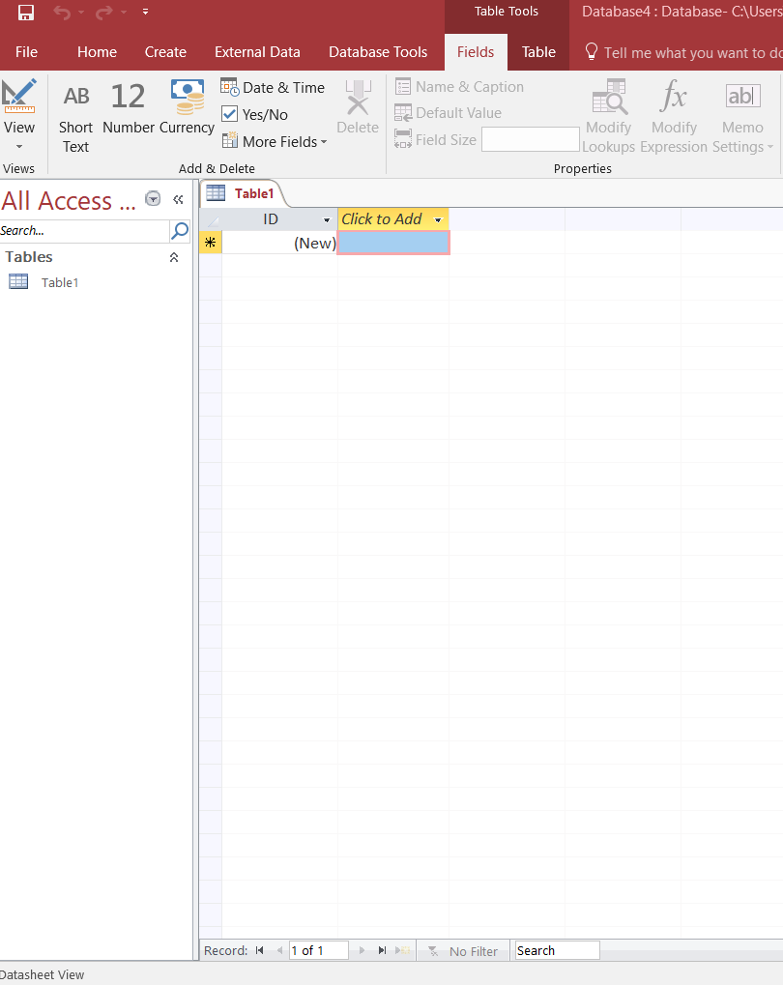
Let’s open Access...
Open a blank database

Slide 43
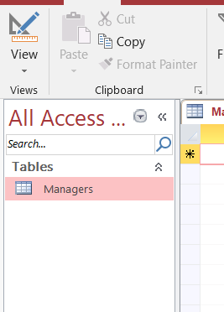
Access
Click ‘view’ and select ‘Design View’
You’ll be required to name and save the table you are creating

Slide 44
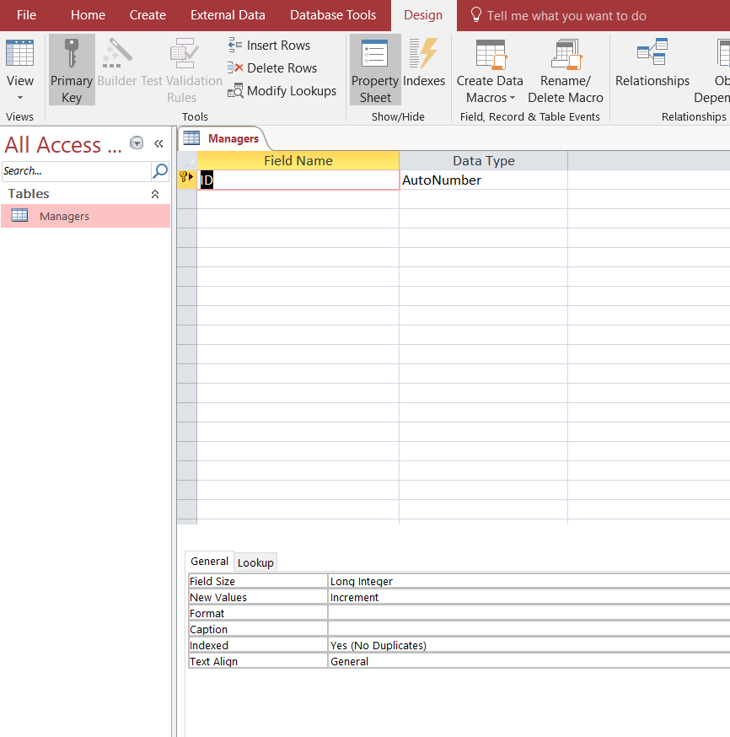
Access
In ‘Design View’, you set the fields for the table by specifying the ‘field name’
Specify the data type through the ‘Data Type’ column
There are many other constraints you can put on the data types (we’re not going to look at this right now)

Slide 45
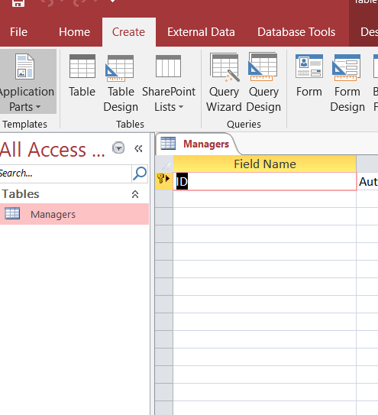
Access
Create another table by going to the ‘Create’ tab and selecting ‘Table’
Repeat the same steps as before to create the fields and datatypes for the entity (table)

Slide 46
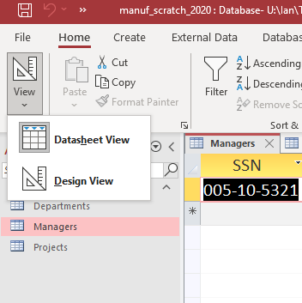
Access
You can go back into the ‘Datasheet’ view in order to enter data into the table you created.
Going back and forth between “Design” view and “Datasheet” view can be a good way to set up your tables.

Slide 47
All Figures from: Fundamentals of Information Systems, 5th Ed., by R. Stair and G. Reynolds (distributed teaching resources)

